Slide 1
The Correction of 3D Reconstructed
Ball Grid Array (BGA) Shape
Presenter: M. C. Hsu 許銘真
E-mail: exo050282@gmail.com
Phone: 0988946307
Notes:
3D 錫球影像的校正

Slide 2
Outline
The Problem
Iterative Reconstruction
ART (Algebraic Reconstruction Technique)
SART (Simultaneous Algebraic Reconstruction Technique)
FBP (Filtered Back Projection)
Notes:
Simultaneous Algebraic Reconstruction Technique 同步代數重建法

Slide 3
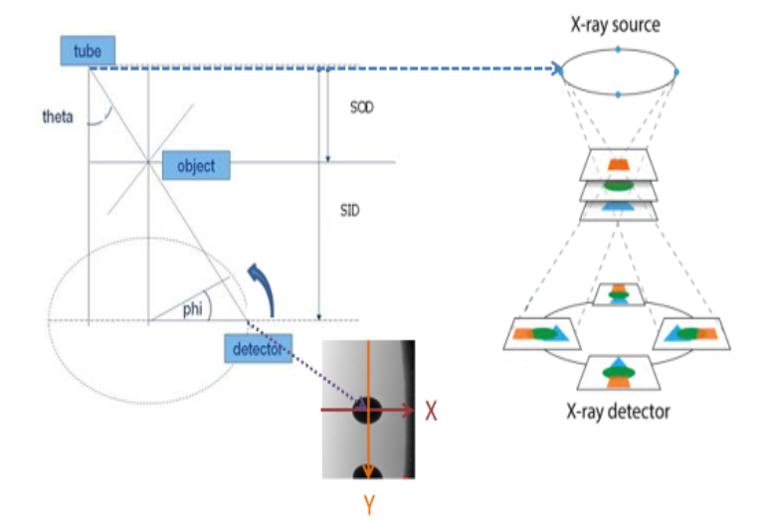
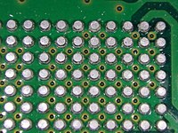
The Problem
SOD: Source to Object Distance
SID: Source to Image Distance
Reconstruction of 3D solder ball
Notes:
Solder: 焊接
PCB（Printed circuit board）
3D: 3 Dimensions
phi : angle of rotation
Theta : the angle between tube to detector and vertical line.

Slide 4
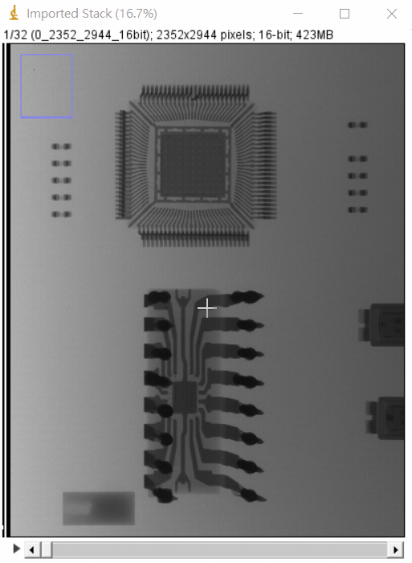
The Problem
32 Projections
Notes:
11.25度

Slide 5
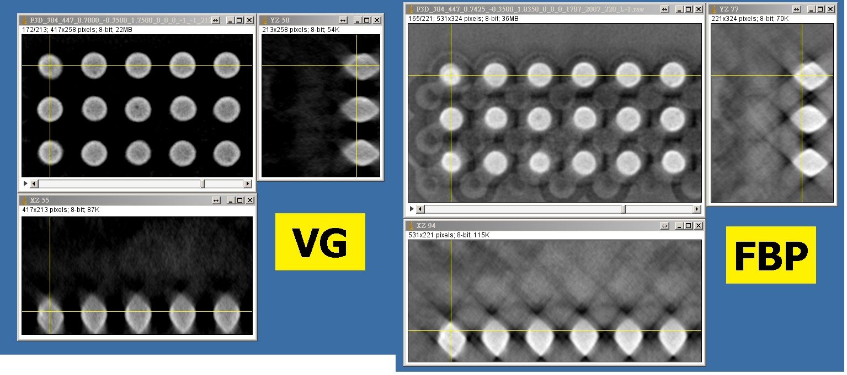
The Problem
VG: Volume Graphics
FBP: Filtered Back Projection
Solder balls are too rhombus.
Image contrast not clear enough (voids are dark spots).
Notes:
Rhombus: 菱形
影像對比度不夠清晰（空隙是黑點）。

Slide 6
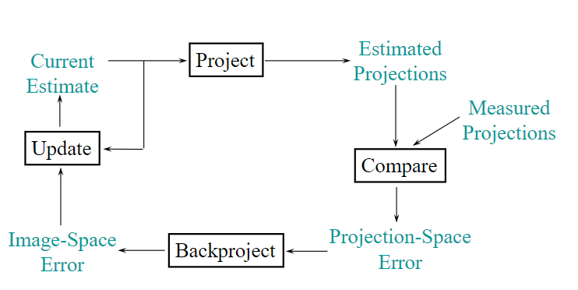
Iterative Reconstruction
Notes:
Measured projections: 實測投影
Estimated projections: 估測影像
projection-space error 投影空間誤差
image-space error:影像空間誤差

Slide 7
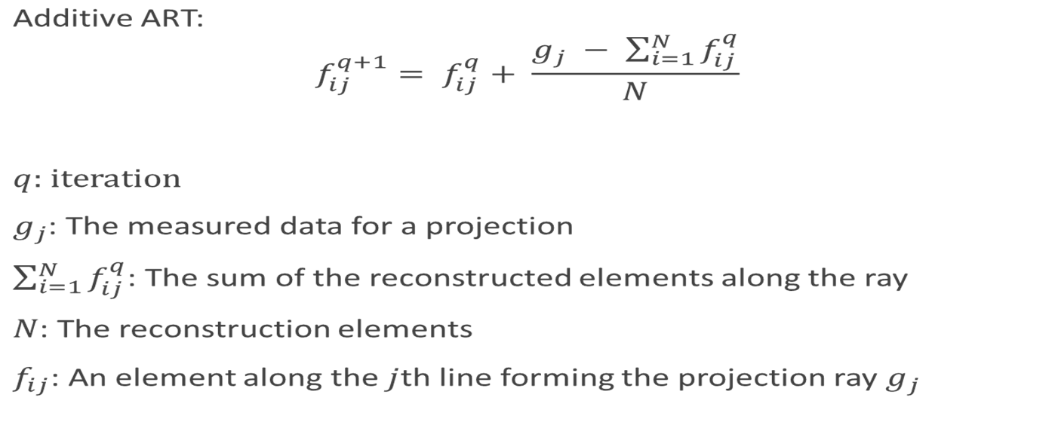
ART (Algebraic Reconstruction Technique)
A classic iterative reconstruction method.
Additive:

Slide 8
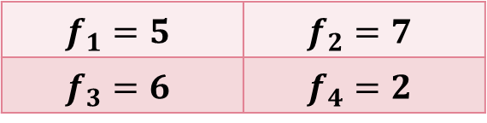
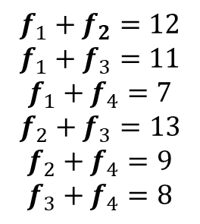
Additive ART
ART: Algebraic Reconstruction Technique
11
9
7
13
$$f_{1}+f_{2}=12$$
$$f_{1}+f_{3}=11$$
$$f_{1}+f_{4}=7$$
$$f_{2}+f_{3}=13$$
$$f_{2}+f_{4}=9$$
$$f_{3}+f_{4}=8$$
12
$$f_{1}=5$$ | $$f_{2}=7$$
$$f_{3}=6$$ | $$f_{4}=2$$
8
Notes:
Orignal
垂直、對角、水平

Slide 9
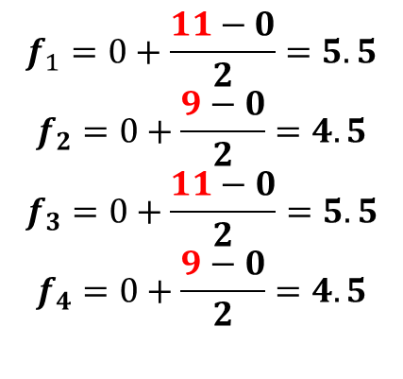
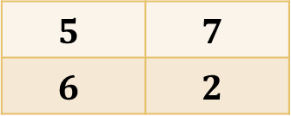
Additive ART
ART: Algebraic Reconstruction Technique
$$5$$ | $$7$$
$$6$$ | $$2$$
Vertical
11
9
0
$$f_{1}=0+\frac{11−0}{2}=5.5$$
$$f_{2}=0+\frac{9−0}{2}=4.5$$
$$f_{3}=0+\frac{11−0}{2}=5.5$$
$$f_{4}=0+\frac{9−0}{2}=4.5$$
0
0 | 0
0 | 0
Notes:
初始0

Slide 10
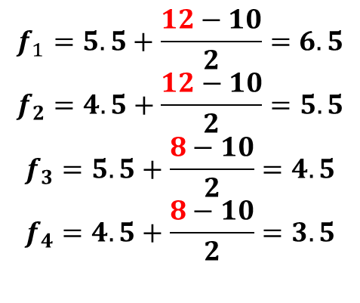
Additive ART
ART: Algebraic Reconstruction Technique
$$5$$ | $$7$$
$$6$$ | $$2$$
Horizontal
$$f_{1}=5.5+\frac{12−10}{2}=6.5$$
$$f_{2}=4.5+\frac{12−10}{2}=5.5$$
$$f_{3}=5.5+\frac{8−10}{2}=4.5$$
$$f_{4}=4.5+\frac{8−10}{2}=3.5$$
5.5 | 4.5
5.5 | 4.5
10
12
10
8
Notes:
初始0

Slide 11
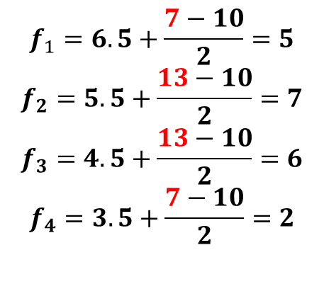
Additive ART
ART: Algebraic Reconstruction Technique
$$5$$ | $$7$$
$$6$$ | $$2$$
Diagonal
7
13
10
10
$$f_{1}=6.5+\frac{7−10}{2}=5$$
$$f_{2}=5.5+\frac{13−10}{2}=7$$
$$f_{3}=4.5+\frac{13−10}{2}=6$$
$$f_{4}=3.5+\frac{7−10}{2}=2$$
6.5 | 5.5
4.5 | 3.5
Notes:
初始0

Slide 12
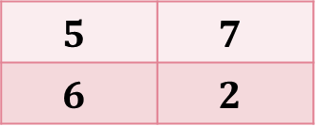
Additive ART
ART: Algebraic Reconstruction Technique
$$5$$ | $$7$$
$$6$$ | $$2$$
Final
$$5$$ | $$7$$
$$6$$ | $$2$$
Notes:
初始0

Slide 13

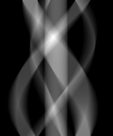
Additive ART
ART: Algebraic Reconstruction Technique
179°
0°
Original image
Sinogram
Notes:
我們通過生成投影來獲得不同角度的投影值，此影像，每個投影 1°，從 1° 到 179°。我們將每個投影的值放在相應的輸出行上
從左開始: 正方=>右三=>圓=>左三=>長方
Sinogram 正玄圖

Slide 14
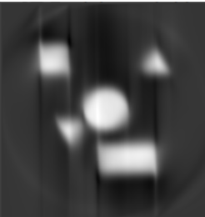
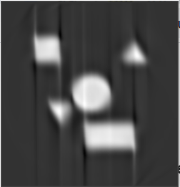
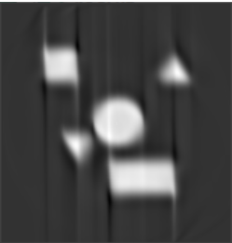
Additive ART
ART: Algebraic Reconstruction Technique
180 Projections
1 Iteration
100 Iterations
500 Iterations

Slide 15
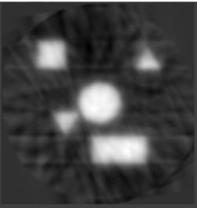
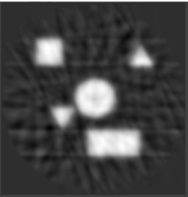

Additive ART
ART: Algebraic Reconstruction Technique
32 Projections
1 Iteration
100 Iterations
500 Iterations
Notes:
跟 180 比，32比較模糊，因為較少的資訊量

Slide 16
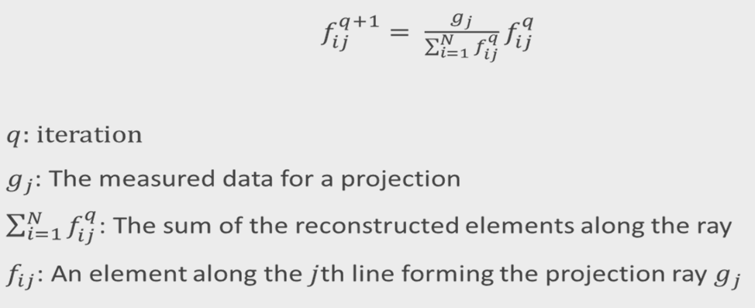
Multiplicative ART
ART: Algebraic Reconstruction Technique
Notes:
Multiplicative: 乘法

Slide 17
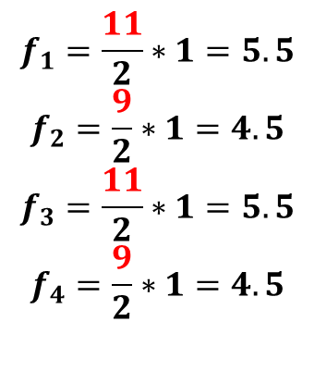
Multiplicative ART
ART: Algebraic Reconstruction Technique
$$5$$ | $$7$$
$$6$$ | $$2$$
Vertical
11
9
2
$$f_{1}=\frac{11}{2}∗1=5.5$$
$$f_{2}=\frac{9}{2}∗1=4.5$$
$$f_{3}=\frac{11}{2}∗1=5.5$$
$$f_{4}=\frac{9}{2}∗1=4.5$$
2
1 | 1
1 | 1
Notes:
初始=>1
分母=>標準
分子=>目前

Slide 18
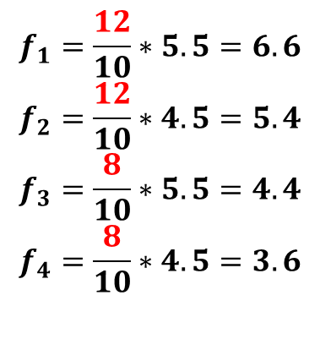
Multiplicative ART
ART: Algebraic Reconstruction Technique
$$5$$ | $$7$$
$$6$$ | $$2$$
Horizontal
$$f_{1}=\frac{12}{10}∗5.5=6.6$$
$$f_{2}=\frac{12}{10}∗4.5=5.4$$
$$f_{3}=\frac{8}{10}∗5.5=4.4$$
$$f_{4}=\frac{8}{10}∗4.5=3.6$$
5.5 | 4.5
5.5 | 4.5
10
12
10
8

Slide 19
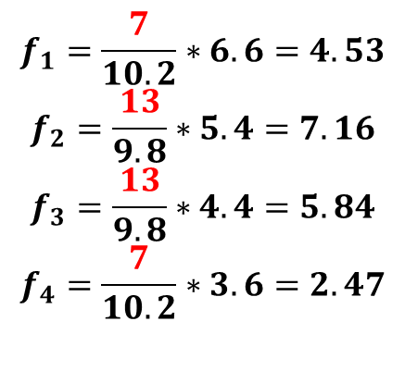
Multiplicative ART
ART: Algebraic Reconstruction Technique
$$5$$ | $$7$$
$$6$$ | $$2$$
Diagonal
7
13
10.2
9.8
$$f_{1}=\frac{7}{10.2}∗6.6=4.53$$
$$f_{2}=\frac{13}{9.8}∗5.4=7.16$$
$$f_{3}=\frac{13}{9.8}∗4.4=5.84$$
$$f_{4}=\frac{7}{10.2}∗3.6=2.47$$
6.6 | 5.4
4.4 | 3.6

Slide 20
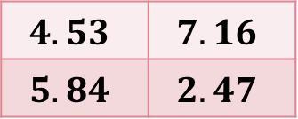
Multiplicative ART
ART: Algebraic Reconstruction Technique
$$5$$ | $$7$$
$$6$$ | $$2$$
Final
$$4.53$$ | $$7.16$$
$$5.84$$ | $$2.47$$

Slide 21
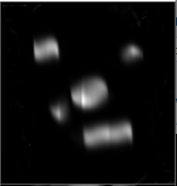
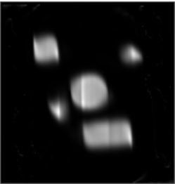
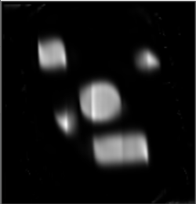
Multiplicative ART
ART: Algebraic Reconstruction Technique
180 Projections
1 Iteration
100 Iterations
500 Iterations

Slide 22
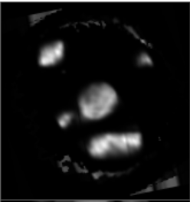
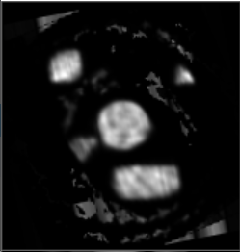
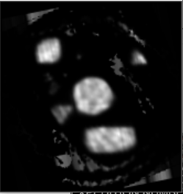
Multiplicative ART
ART: Algebraic Reconstruction Technique
32 Projections
1 Iteration
100 Iterations
500 Iterations

Slide 23
Additive vs Multiplicative
ART: Algebraic Reconstruction Technique
Additive ART has better image quality, but more noise is present.
Given less projections, Additive ART gives a more complete picture while Multiplicative ART introduces a lot of previously non-existent entities.
Additive
180 Projections
500 Iterations
Multiplicative
180 Projections
500 Iterations
Additive
32 Projections
500 Iterations
Multiplicative
32 Projections
500 Iterations
Notes:
Additive ART 具有更好的圖像質量，影像更完整，但存在更多噪聲。
由於投影較少，Additive ART 提供了更完整的圖片，而 Multiplicative ART 引入了許多以前不存在的實體。

Slide 24
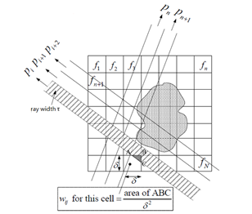
SART: Simultaneous Algebraic Reconstruction Technique
Considers all projection rays in one iteration
Resist noise
Generate better reconstructed image
Notes:
SART同步代數重建法
ART 中每次迭代考慮一根投影射線
SART考慮所有投影射線
抗噪，ART中的噪声进行了平滑，
可以生成更好的重建圖像。
=============================================================================================================
ART 每一次迭代只能修正一條射線上的值；實際上，空間中每個voxel 在一次迭代的運算中，不只一條射線穿過它，所以SART 可以同時修正同一個投影中的所有射線估測值
因此收斂速度上會比ART 快一些

Slide 25
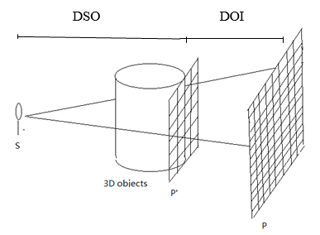
3D Reconstruction by SART
SART: Simultaneous Algebraic Reconstruction Technique
DOI: Distance between Object and Image
DSO: Distance between Source and Object
Notes:
As for the process of 3D reconstruction, we just conduct a reverse operation. We use image P to interpolate image P’.
After acquiring P’ in different angles, we can use SART to reconstruct the 3D object layer by layer.
至於3D重建的過程，我們只是進行了逆向操作。我們使用圖像 P 來插入圖像 P'。在不同角度獲取P’後，我們可以使用SART逐層重建3D對象。

Slide 26
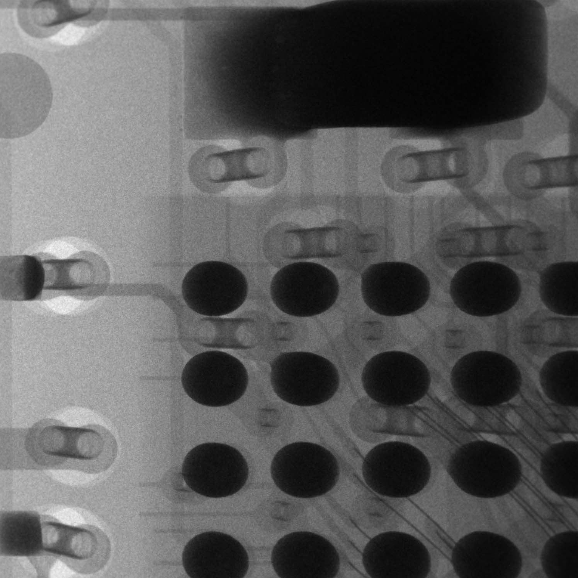
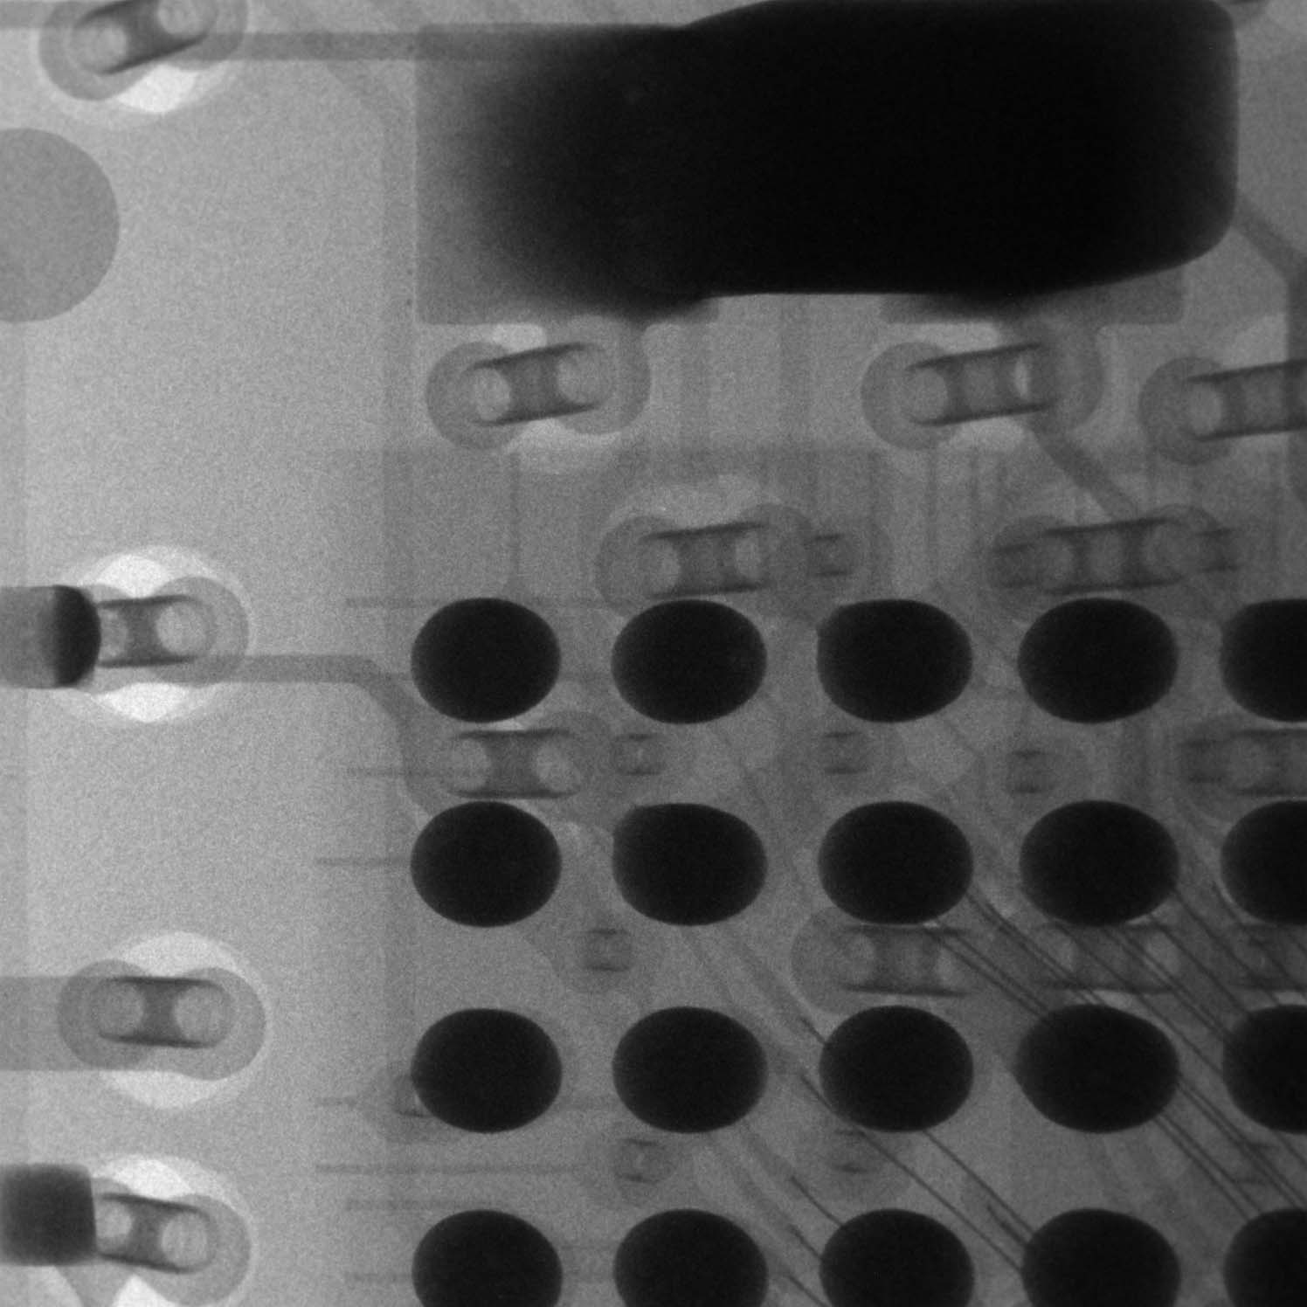
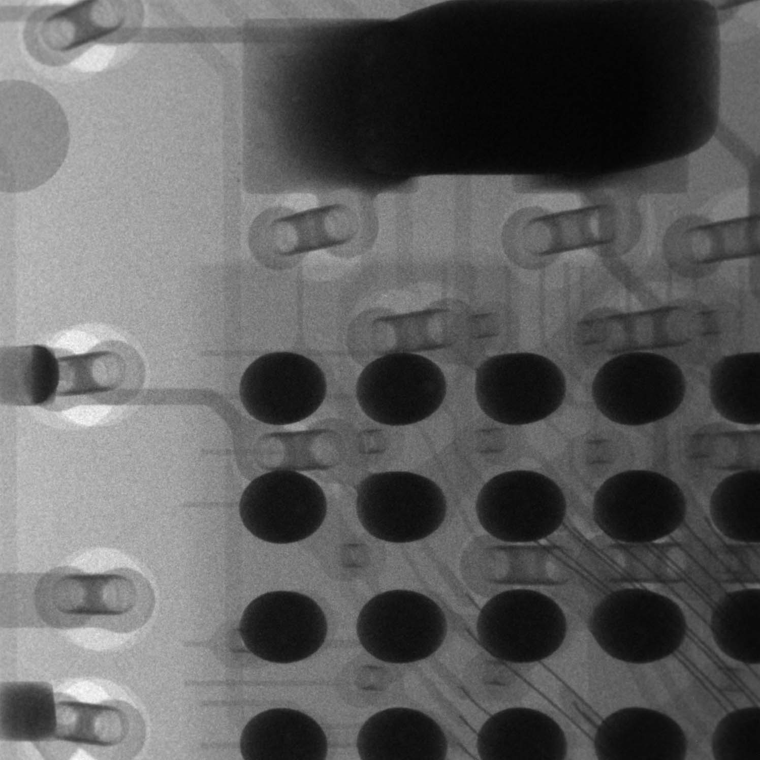
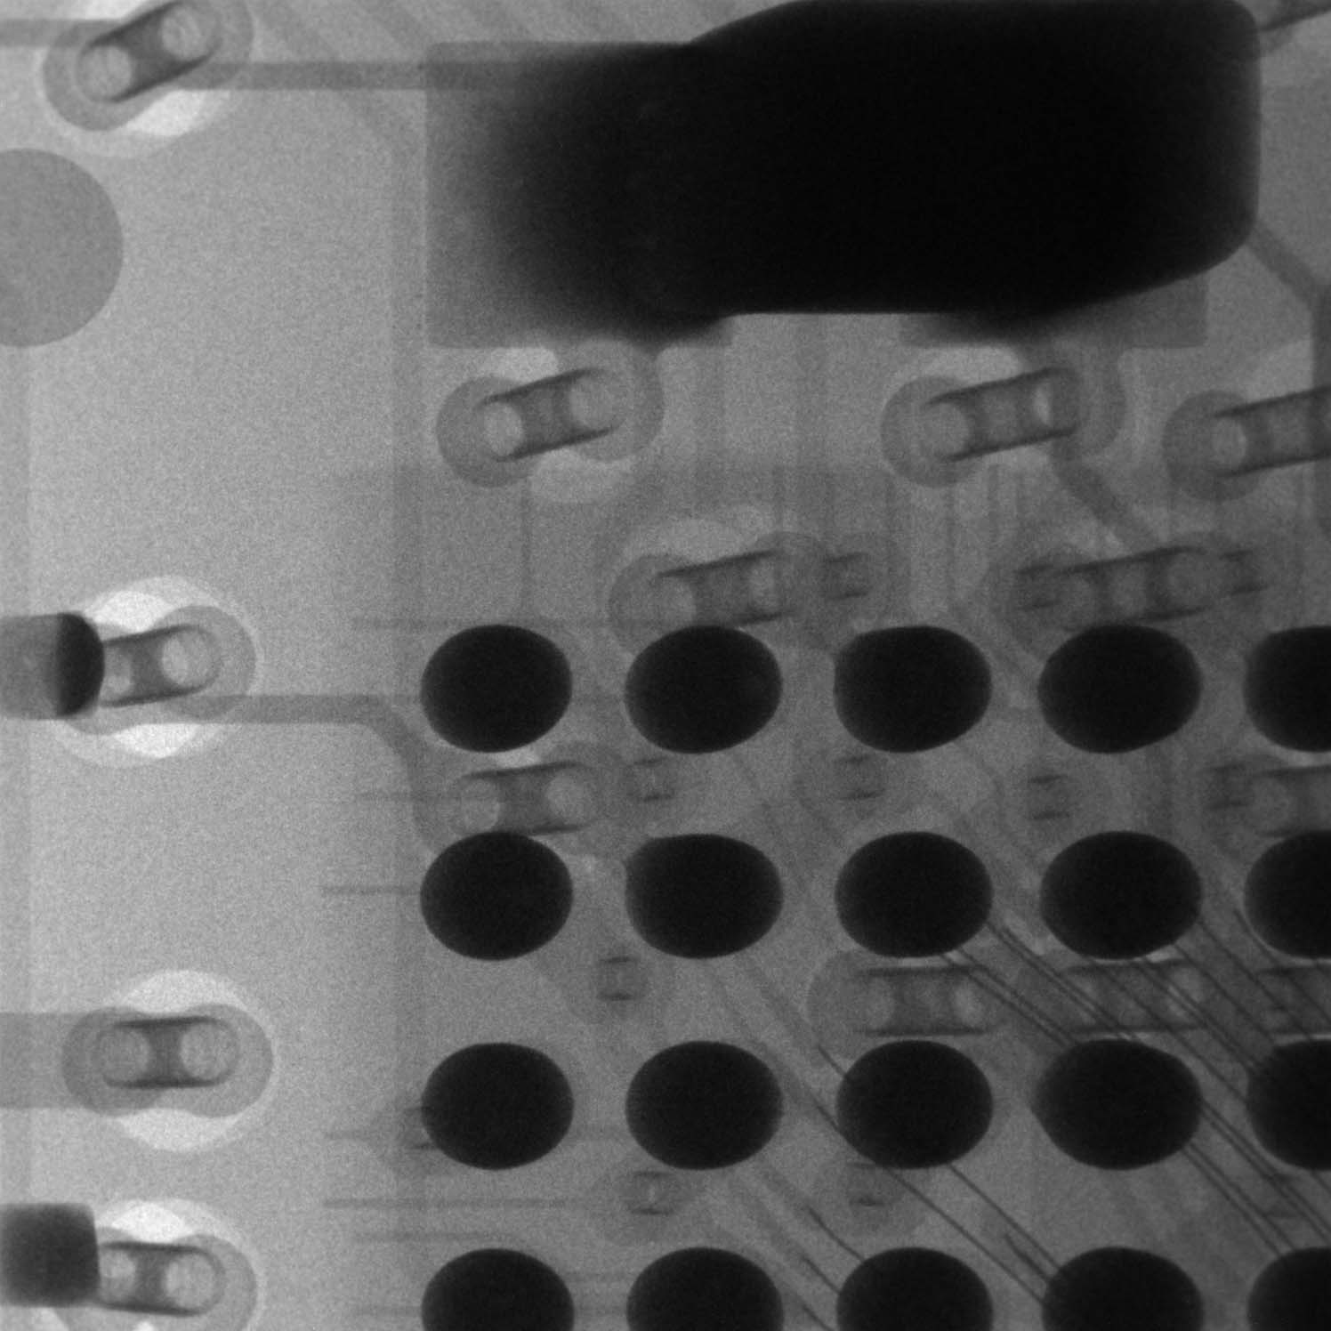

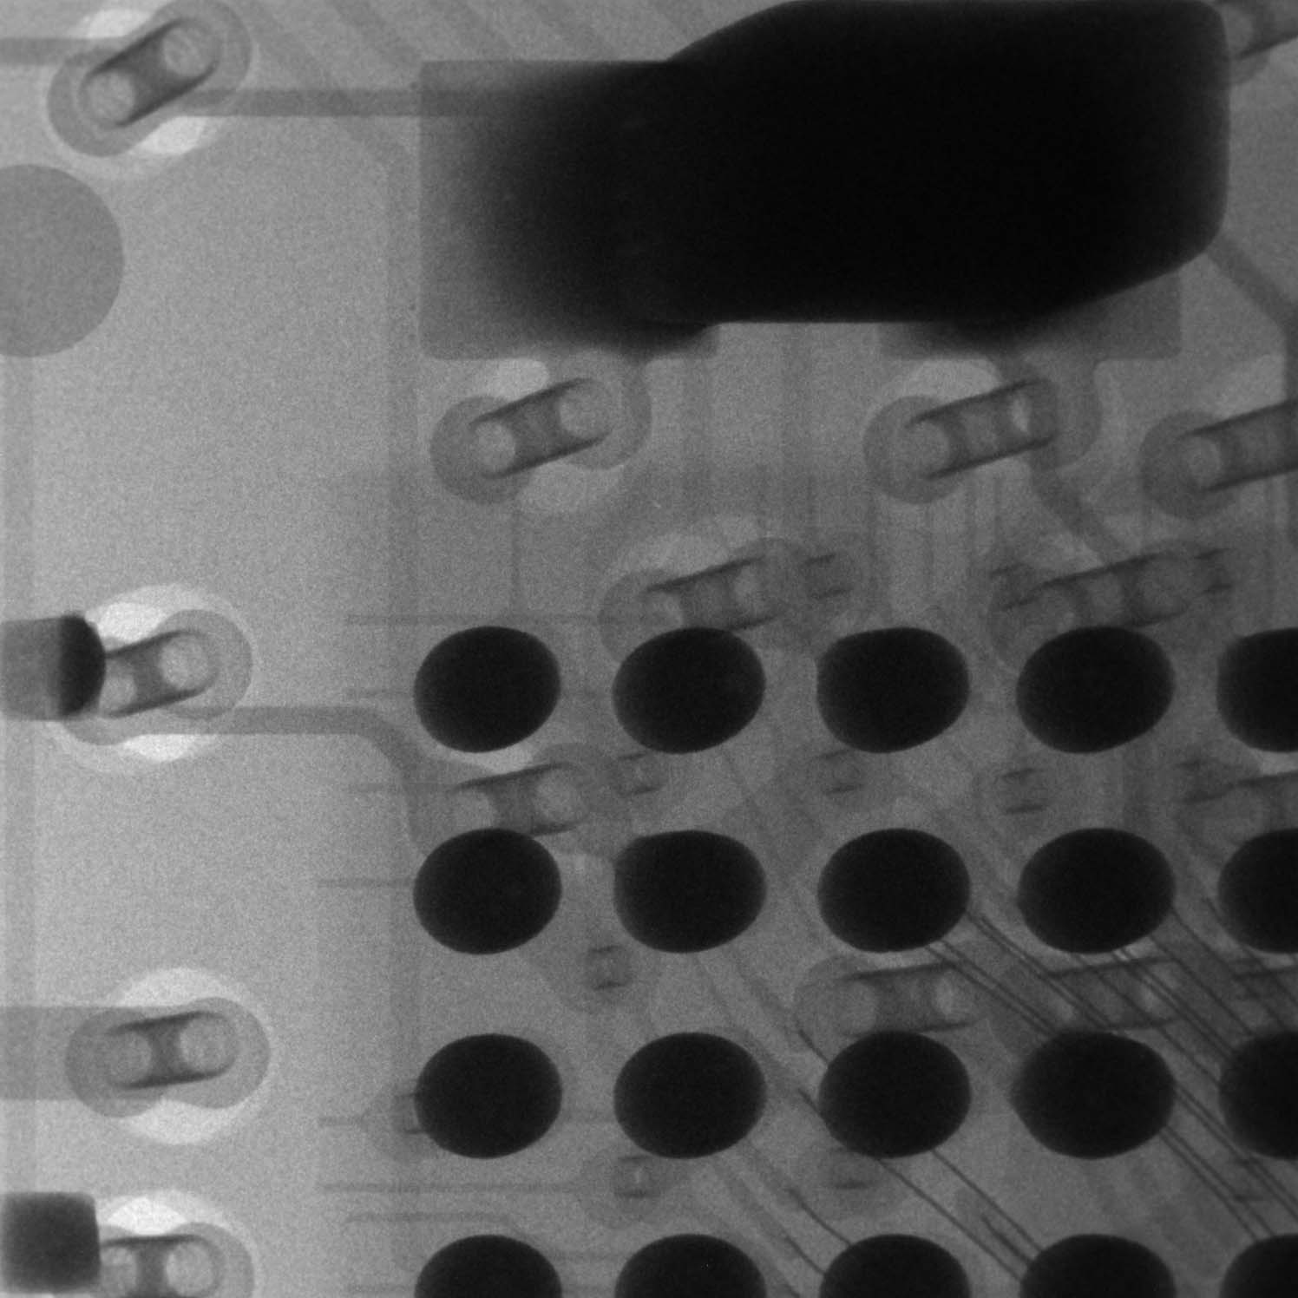
3D Reconstruction by SART (128 Projections)
SART: Simultaneous Algebraic Reconstruction Technique
. . . . . .

Slide 27
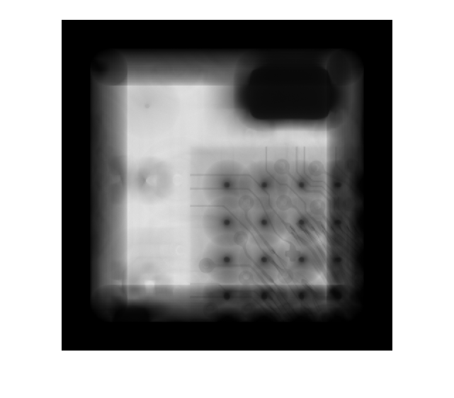

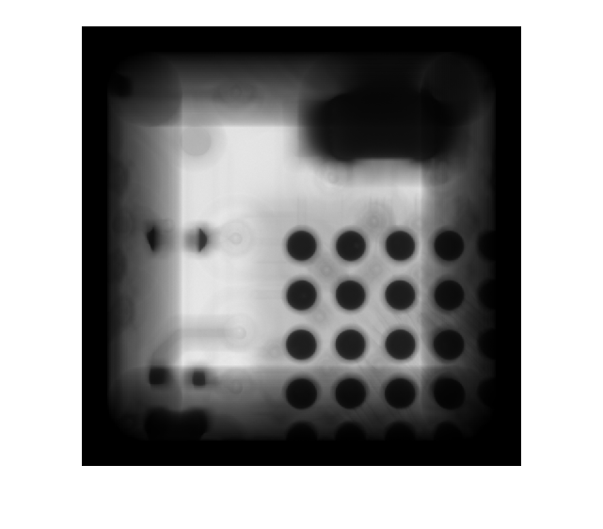
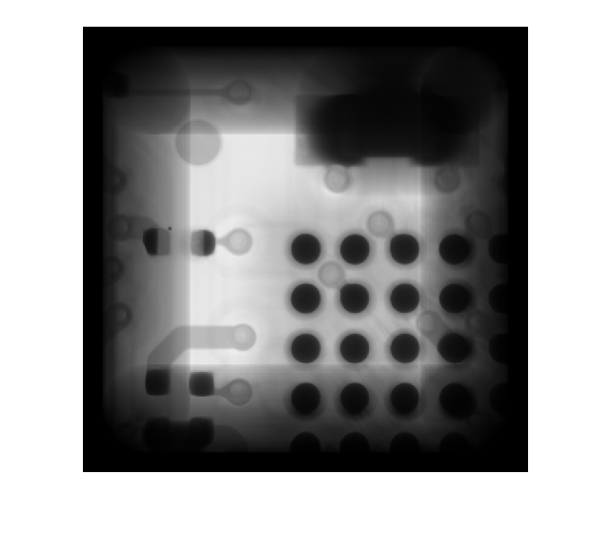
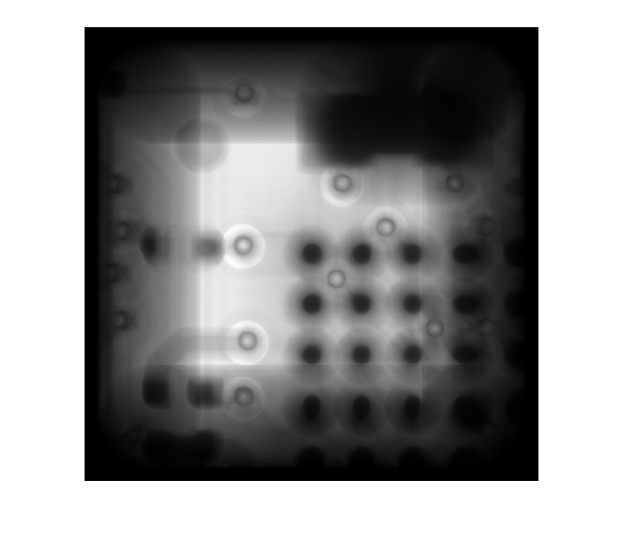
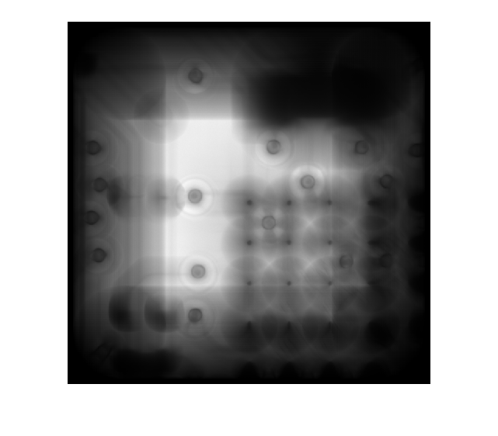
3D Reconstruction by SART (128 Projections)
SART: Simultaneous Algebraic Reconstruction Technique
Height z = 120
Height z = 100
Height z = 80
Height z = 60
Height z = 40
Height z = 20

Slide 28
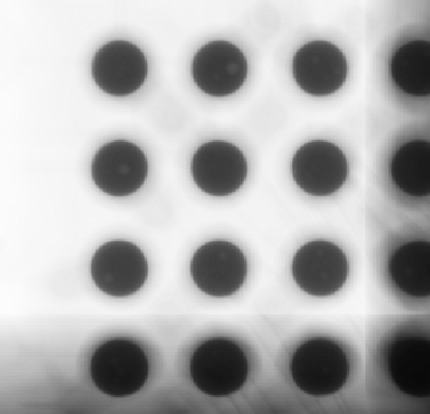
3D Reconstruction by SART (128 Projections)
SART: Simultaneous Algebraic Reconstruction Technique
Even after increasing contrast, void is visible but unclear
Notes:
把其中一部分放大，且在增加對比的情況下，空隙是可見的但還是不清楚

Slide 29
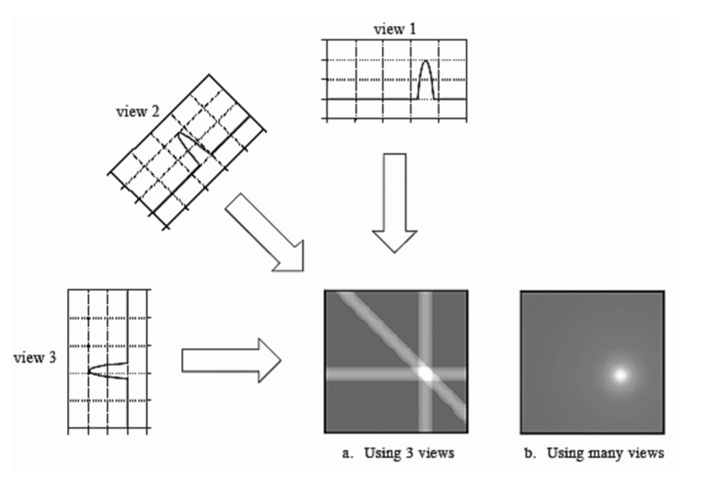
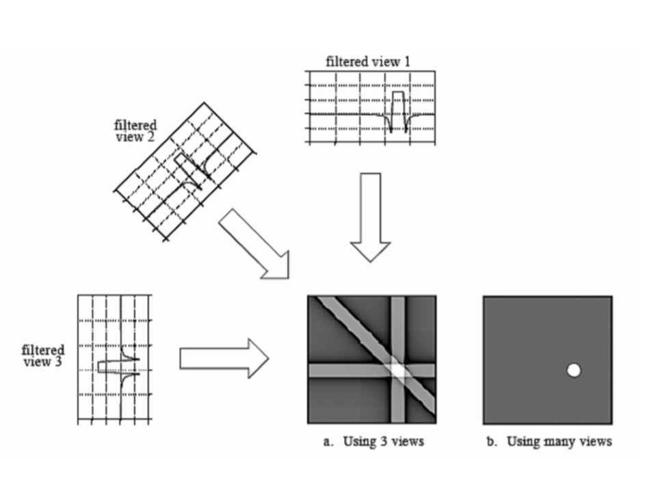
FBP: Filtered Back Projection
Back Projection
Filter Back Projection
Star Artifact
Remove the Blur Place
Notes:
Back projection reconstructs an image by taking each angle view.
反投影通過獲取每個角度視圖來重建圖像。

Slide 30
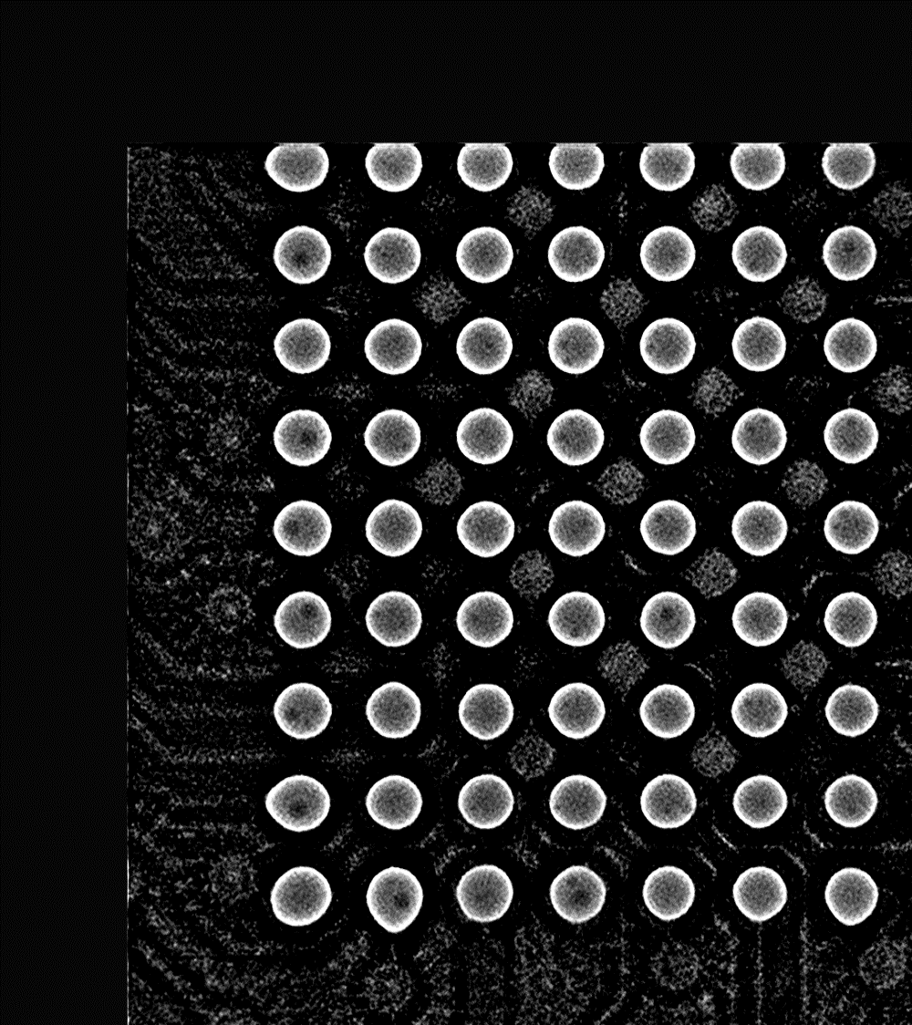
FBP: Filtered Back Projection
FBP
Projection images with different rotations.
The reconstructed image by FBP.

Slide 31
FBP - Pipeline
FBP: Filtered Back Projection
Input Image
Back Projection
Normalization
Create Filter
Inverse Fourier Transform
Output
Fourier Transform
Filter
Notes:
Ramp filter=> 高通濾波
Hann filter
Hamming filter
Cosine filter
Shepp-Logan filter
We use the Hann filter due to higher contrast.

Slide 32
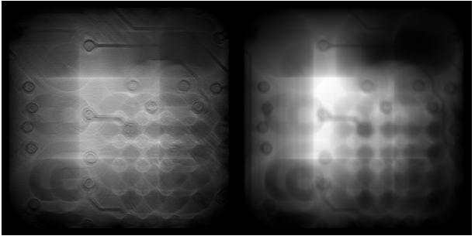
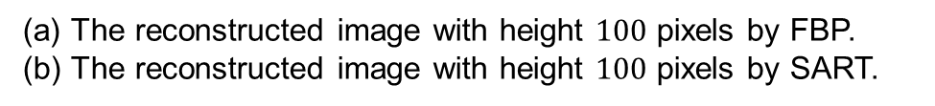
FBP vs SART
SART: Simultaneous Algebraic Reconstruction Technique
FBP: Filtered Back Projection
(a)
(b)
(a) The reconstructed image with height $100$ pixels by FBP.
(b) The reconstructed image with height $100$ pixels by SART.

Slide 33
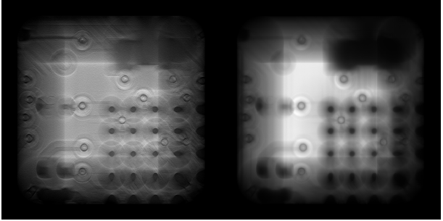
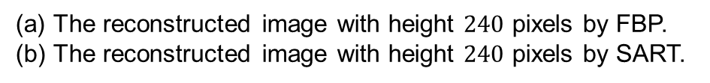
FBP vs SART
SART: Simultaneous Algebraic Reconstruction Technique
FBP: Filtered Back Projection
(a)
(b)
(a) The reconstructed image with height $240$ pixels by FBP.
(b) The reconstructed image with height $240$ pixels by SART.

Slide 34
References
https://en.wikipedia.org/wiki/Solder_ball
https://slideplayer.com/slide/4893938/, 2015.
https://www.slideshare.net/DanielePelliccia/from-filtered-backprojection-to-statistical-tomography-reconstruction, 2018.
https://www.slideshare.net/ZhejianPeng/zjpeng3dsolderballreconstruction, 2017.
https://youtu.be/CwXgFtx6vxs?t=80, 2017.
Hung-Yi Chen, ”3D Reconstruction with X-Ray Images”, 2017.
https://link.springer.com/chapter/10.1007/978-981-10-2772-7_6, 2016.
https://blog.csdn.net/pannn0504/article/details/78357607, 2018.
https://zh.wikipedia.org/wiki/%E5%85%89%E6%B5%81%E6%B3%95
https://www.cnblogs.com/zyly/p/9508131.html, 2018.
https://www.itread01.com/content/1544874242.html, 2018.
https://en.wikipedia.org/wiki/Scale-invariant_feature_transform
https://sci-hub.se/10.1109/nssmic.2012.6551902, 2013.

